Slide 1



API part 2
Integrative Programming

Slide 2



Outline
Create REST API using Node.JS
www.its.ac.id
INSTITUT TEKNOLOGI SEPULUH NOPEMBER, Surabaya - Indonesia

Slide 3
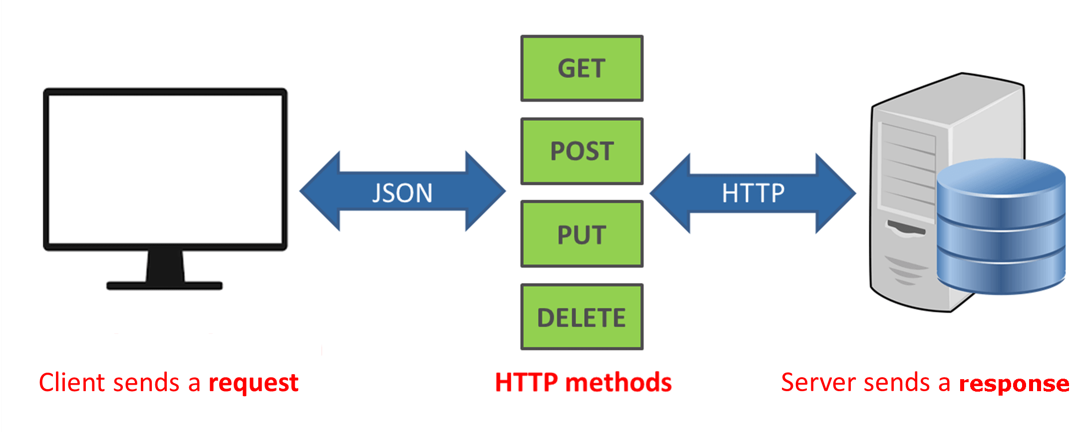
REST API
REST APIs also known as RESTful API is API that comforts to the constraints of REST architectural style
Provide a flexible, lightweight way to integrate applications
Example: Twitter API, Google API
www.its.ac.id
INSTITUT TEKNOLOGI SEPULUH NOPEMBER, Surabaya - Indonesia

Slide 4
REST API
POST
Create data
GET
Read data
PUT
Update data
DELETE
Delete data
CRUD Operation
www.its.ac.id
INSTITUT TEKNOLOGI SEPULUH NOPEMBER, Surabaya - Indonesia

Slide 5
Address end point
The domain
The endpoint
http://example.com/api/{endpoint}
The protocol
We can use HTTP or HTTPS
The sub-domain
www.its.ac.id
INSTITUT TEKNOLOGI SEPULUH NOPEMBER, Surabaya - Indonesia

Slide 6
HTTP Methods
GET
POST
PUT
DELETE
www.its.ac.id
INSTITUT TEKNOLOGI SEPULUH NOPEMBER, Surabaya - Indonesia

Slide 7
GET
http://example.com/api/customers
Request
Response
[ {id: 1, name: “x”}, {id: 2, name: ”y”},
… ]
GET /api/customers
www.its.ac.id
INSTITUT TEKNOLOGI SEPULUH NOPEMBER, Surabaya - Indonesia

Slide 8
GET a single value
http://example.com/api/customers/i
Request
Response
{id: 1, name: “x”}
GET /api/customers/1
www.its.ac.id
INSTITUT TEKNOLOGI SEPULUH NOPEMBER, Surabaya - Indonesia

Slide 9
UPDATE
http://example.com/api/customers/
Request
Response
{id: 1, name: “a”}
PUT /api/customers/1
Body → {name: ‘a’}
www.its.ac.id
INSTITUT TEKNOLOGI SEPULUH NOPEMBER, Surabaya - Indonesia

Slide 10
DELETE
http://example.com/api/customers/
Request
Response
DELETE /api/customers/1
www.its.ac.id
INSTITUT TEKNOLOGI SEPULUH NOPEMBER, Surabaya - Indonesia

Slide 11
CREATE
http://example.com/api/customers/
Request
Response
{id: 3, name: “b”}
POST /api/customers
Body → {name: ‘b’}
www.its.ac.id
INSTITUT TEKNOLOGI SEPULUH NOPEMBER, Surabaya - Indonesia

Slide 12
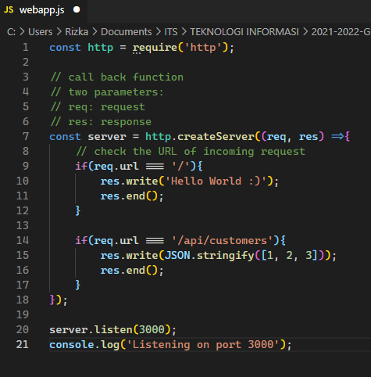
Web Server
Not maintainable
If we add new endpoint we have to add if block in the callback function
The framework need to maintained the structure
www.its.ac.id
INSTITUT TEKNOLOGI SEPULUH NOPEMBER, Surabaya - Indonesia

Slide 13
Express
Install Express
Go to https://expressjs.com/en/starter/installing.html
www.its.ac.id
INSTITUT TEKNOLOGI SEPULUH NOPEMBER, Surabaya - Indonesia

Slide 14
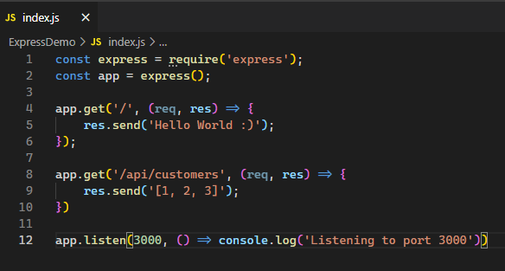
Hello World
www.its.ac.id
INSTITUT TEKNOLOGI SEPULUH NOPEMBER, Surabaya - Indonesia

Slide 15
Nodemon
Every time we change the code we need to stop the server and re-run it again
Nodemon (Node monitor) can handle this problem
Install Nodemon
npm install –g nodemon
When running the .js in terminal, you can use
nodemon {your JS file}
www.its.ac.id
INSTITUT TEKNOLOGI SEPULUH NOPEMBER, Surabaya - Indonesia

Slide 16
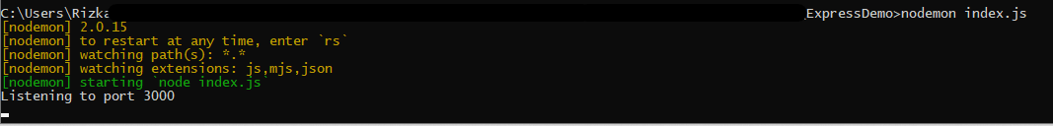
Nodemon
www.its.ac.id
INSTITUT TEKNOLOGI SEPULUH NOPEMBER, Surabaya - Indonesia

Slide 17



GET with parameter
Get certain customers by parameter (e.g. id)
Multiple parameters
www.its.ac.id
INSTITUT TEKNOLOGI SEPULUH NOPEMBER, Surabaya - Indonesia

Slide 18
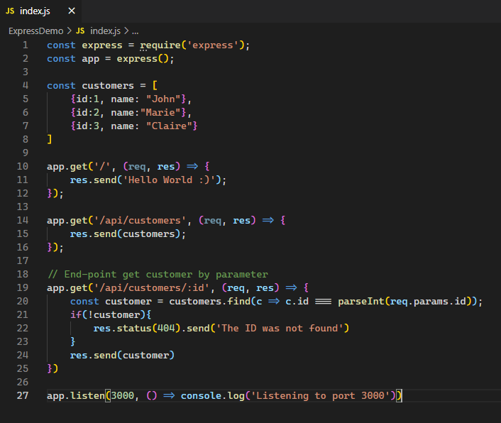
Handling unknown parameter
www.its.ac.id
INSTITUT TEKNOLOGI SEPULUH NOPEMBER, Surabaya - Indonesia

Slide 19
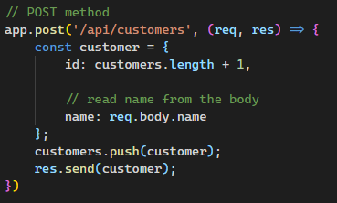
POST method
www.its.ac.id
INSTITUT TEKNOLOGI SEPULUH NOPEMBER, Surabaya - Indonesia

Slide 20
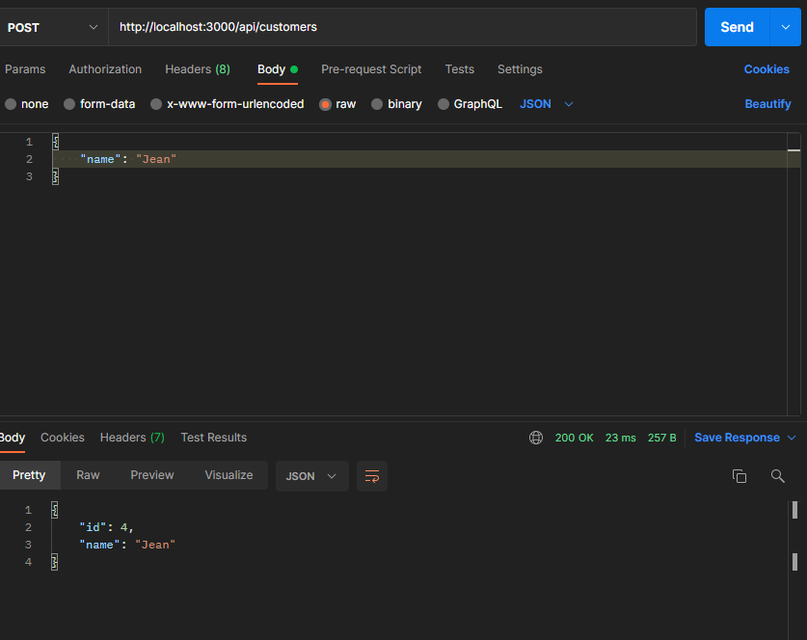
Test the endpoint using postman
www.its.ac.id
INSTITUT TEKNOLOGI SEPULUH NOPEMBER, Surabaya - Indonesia

Slide 21
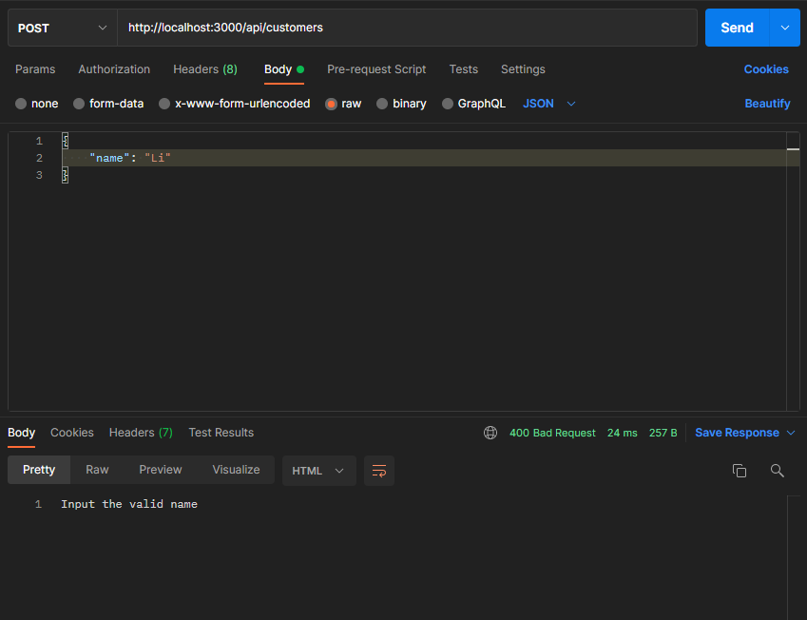
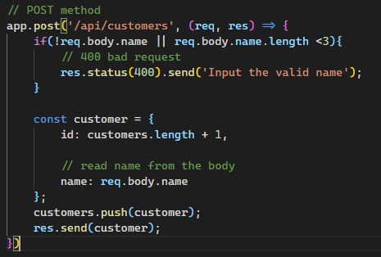
POST method
What if the body is empty? Or the value is not valid?
We have to give the validation
www.its.ac.id
INSTITUT TEKNOLOGI SEPULUH NOPEMBER, Surabaya - Indonesia

Slide 22
PUT method
Modified resource
Look up the resource -> customers
If not exist, return 404
Validate
Update course
Return the updated course
www.its.ac.id
INSTITUT TEKNOLOGI SEPULUH NOPEMBER, Surabaya - Indonesia

Slide 23
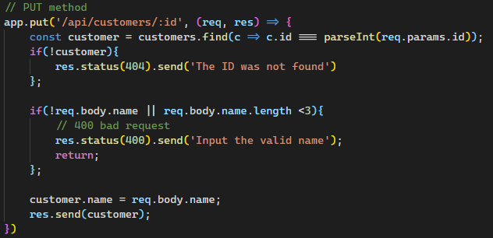
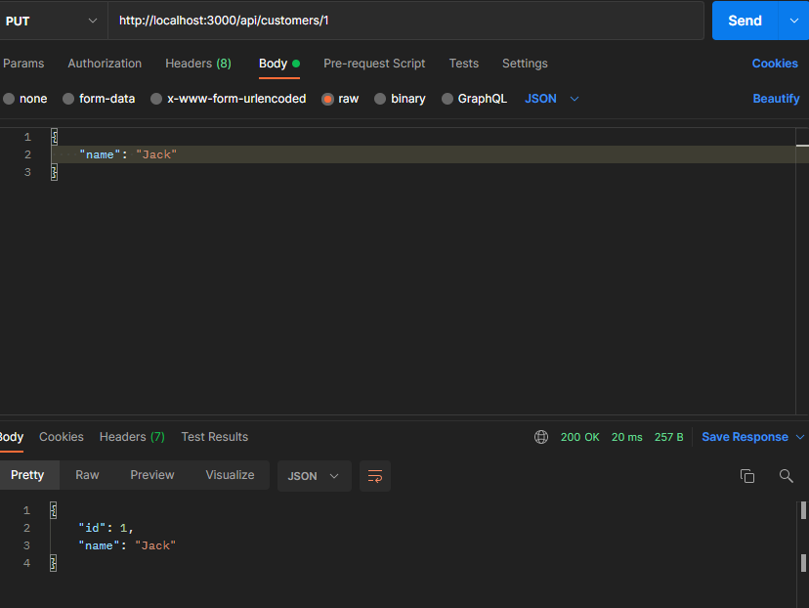
PUT method
www.its.ac.id
INSTITUT TEKNOLOGI SEPULUH NOPEMBER, Surabaya - Indonesia

Slide 24
DELETE method
Modified resource
Look up the resource -> customers
If not exist, return 404
Delete
Return the course
www.its.ac.id
INSTITUT TEKNOLOGI SEPULUH NOPEMBER, Surabaya - Indonesia

Slide 25
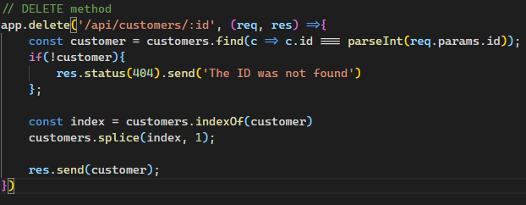
DELETE method
www.its.ac.id
INSTITUT TEKNOLOGI SEPULUH NOPEMBER, Surabaya - Indonesia

Slide 26
TERIMA KASIH

